Slide 1
Toxicity Detection From Tweets Using Machine Learning Approaches
PRESENTED BY
SUBMITTED TO
Md. Kamrozzaman Bhuiyan | - | 180104063
Rahat Chowdhury | - | 180104067
Md. Rakibul Islam | - | 180104072
Farzad Ahmed,
Sajib Kumar Saha Joy
Lecturer
Department of CSE, AUST

Slide 2
PROBLEM DOMAIN
01
02
03
Toxicity detection from tweets
Comparison of different classifier models
Raising awareness against Cyberbullying
01

Slide 3
Motivation
Spread of toxicity is high.
Safe online platform.
Healthy communication system.
Freedom of speech.
02

Slide 4
Hate me, hate me not: Hate speech detection on Facebook
Used Facebook as a benchmark.
Proposed different types of hate categories.
Three-class dataset and Two-class dataset.
10-fold cross validation.
SVM 72.95% and LSTM 75.23%.
03

Slide 5
Hate Speech Detection with Comment Embeddings
Proposed two step method.
Paragraph2vec.
Continuous BOW.
Yahoo Finance website dataset.
AUC 0.7889 in BOW(tf), 0.6933 in BOW(tf-idf) and 0.8007 in paragraph2vec
04

Slide 6
Detecting Hate Speech on the WorldWideWeb
Detected hate speech in online text.
Observed hatred against each different group.
accuracy 94%, precision of 68%, recall at 60% and F1 measure of 0.6375.
05

Slide 7
Cyber Bullying Detection Using Social and Textual Analysis
Used both textual and social network features.
90000 Tweets from various user.
J48, Naive Bayes, SMO, Bagging and Dagging, ZeroR.
Better performance for Dagging than other models.
06

Slide 8
Dataset
Toxic Tweets dataset.
56,744 labeled tweets.
24,153 toxic tweets.
32,592 non-toxic tweets.
07

Slide 9
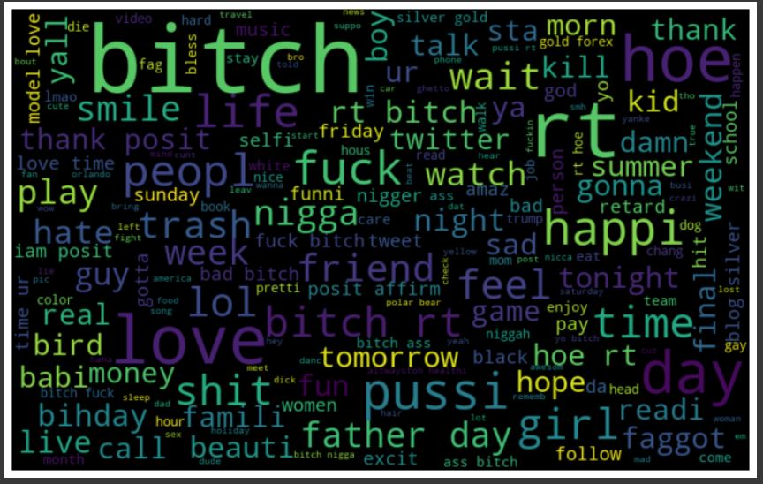
Dataset
08

Slide 10
Methodology
KNN
05
Decision Tree
01
Naïve Bayes
SVC
02
06
03
AdaBoost
07
Random Forest
04
Logistic Regression
09

Slide 11
Result Analysis
KNN
Accuracy 71%
MSE 0.29
RMSE 0.54
R-Squared 0.64
10

Slide 12
Result Analysis
Naïve Bayes
Accuracy 91%
MSE 0.89
RMSE 0.29
R-Squared 0.88
11

Slide 13
Result Analysis
AdaBoost
Accuracy 92%
MSE 0.08
RMSE 0.29
R-Squared 0.89
12

Slide 14
Result Analysis
Decision Tree
Accuracy 93%
MSE 0.07
RMSE 0.27
R-Squared 0.91
13

Slide 15
Result Analysis
SVC
Accuracy 94%
MSE 0.06
RMSE 0.24
R-Squared 0.93
14

Slide 16
Result Analysis
Random Forest
Accuracy 94%
MSE 0.06
RMSE 0.25
R-Squared 0.93
15

Slide 17
Result Analysis
Logistic Regression
Accuracy 94%
MSE 0.06
RMSE 0.25
R-Squared 0.92
16

Slide 18
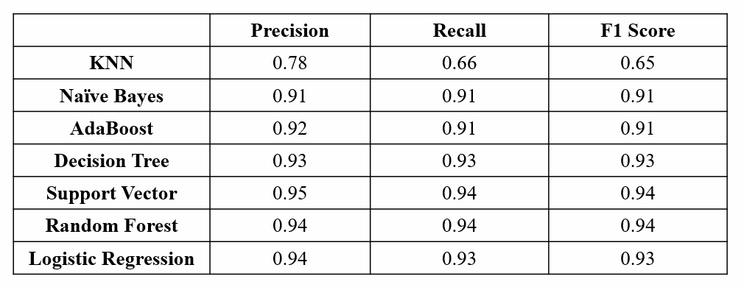
Result Analysis
17

Slide 19
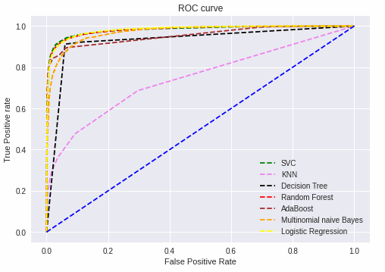
Result Analysis
18

Slide 20
Future Works
Platform Independent.
Large Dataset.
Toxicity Score.
19

Slide 21
Thank You

